Slide 1
Reference-Based pricing Plans
www.usi.com

Slide 2
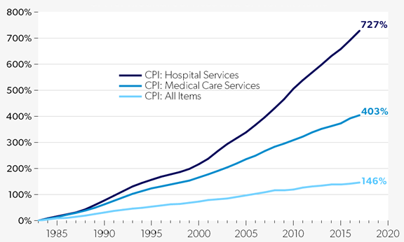
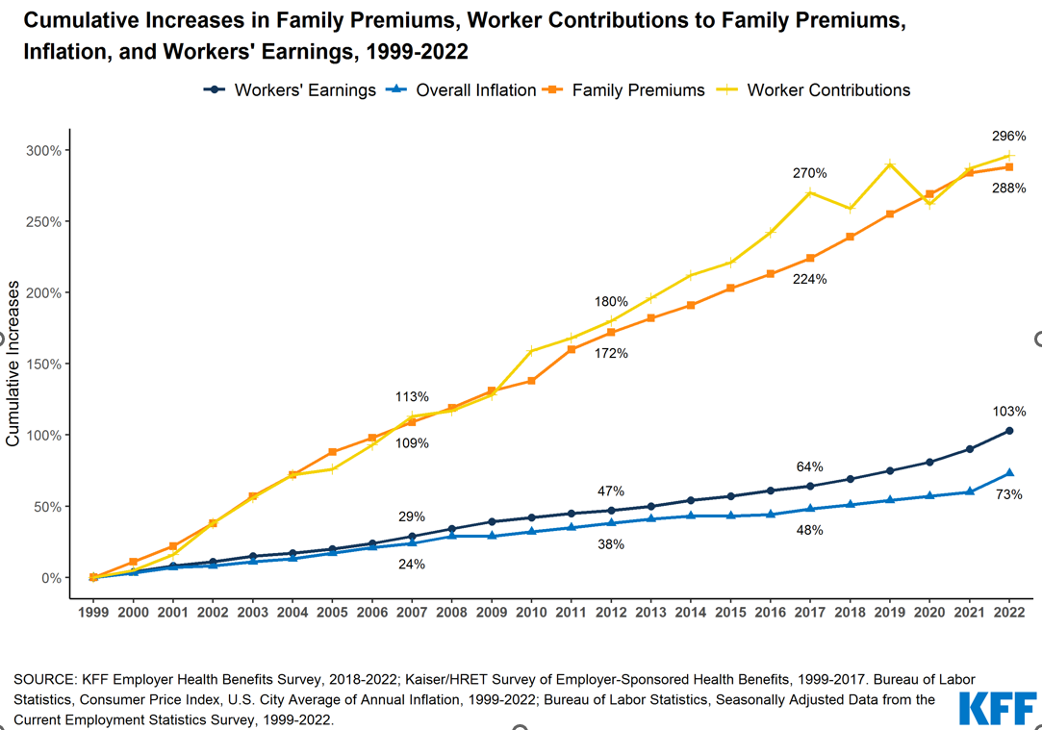
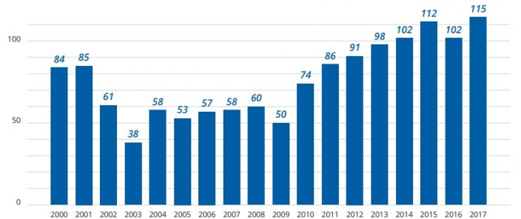
Hospitals’ Role in Rising US Healthcare Costs
US Healthcare costs are ~50% higher than other developed countries, in part driven by hospital consolidation and acquisition of physician practices, increasing provider negotiating power, resulting in higher reimbursements.
Price Increases from 1983 to 2017: CPI for Hospital Services, CPI for Medical and CPI for All Items ¹
Hospital costs represent ~50% of all total employer-based healthcare costs.
US healthcare costs differences cannot be solely attributed to unhealthy lifestyles or to improved outcomes based on more expensive care.
Hospital acquisition of physician practices creates contractually negotiated higher reimbursements by the physician now owned by a hospital.
The insurance industry and PPOs have failed to control employer-funded healthcare costs.
Hospital and Health System M&A Activity, 2000-2017 ²
Cumulative Increases in Family Premiums, Worker Contributions to Family Premiums, Inflation, and Workers’ Earnings, 1999-2022
Cumulative Increases

Slide 3


Challenges with PPO Network Model
Traditional PPO networks negotiate hospital discounts from arbitrary and inflated “billed charges,” with less emphasis on actual cost.
EXAMPLE:
Cost of MRI at two different In-Network Hospitals
The largest priority of PPO networks is typically providing access to care and negotiating discounts, as opposed to reducing actual per unit cost.
PPO networks offer members convenience with little focus or direction on actual cost of services.
This example demonstrates the wide inconsistency in costs for the same procedure performed at different IN-NETWORK facilities.
Network and provider contracted rates are protected by confidentiality agreements.
In-Network
Hospital A
In-Network Hospital B
$1,500
52%
$720
Billed Charge
PPO Network Discount
Plan Pays
$6,000
52%
$2,880
Because of the PPO contracts & plan designs, members are unaware/unaffected by these pricing differences and lack the information to make an informed decision.

Slide 4
Reimbursement Examples: RBP vs. Traditional FFS
$75,000
Traditional Fee-for-Service Reimbursement
Top-down Pricing The hospital sets the price and the plan has a PPO contract for ≈50% discount off hospital’s price
Charge Master Rate
Top-down Pricing (e.g., PPO)
$50,000
PPO Price: $37,500
Plan Savings: $15,250
$25,000
Reference-Based Pricing Reimbursement
Bottom-up Pricing RBP health plan pays the hospital a percentage above the Medicare reimbursement (140% in this example)
RBP Price: $22,250 (140% of Medicare)
Medicare Reimbursement Rate: $15,893
Bottom-up Pricing
$0

Slide 5
Cost Savings are Significant
USI clients have experienced savings in excess of 30% when implementing RBP. Long-term cost avoidance is increased due to lower Medicare trend of 1 – 2% as compared to 6% or more for PPOs.
Actual USI Client Financial Impact
USI conducted a national panel discussion with consultants, underwriters and compliance attorneys to evaluate and learn from our collective RBP experiences.
Savings are generated from significantly lower costs in In-patient and Out-patient services.
A moderate increase in physician or professional services should be expected.
Savings are inclusive of administrative fees to run the program.
Employees | Client | RBP Vendor | Medical & RX PEPY |  | Savings
 |  |  | 1 Year Prior to RBP | Year 1 for RBP
196 | Client 1 | Clear Health Strategies | $5,528 | $3,569 | 35%
200 | Client 2 | Inetico | $7,007 | $4,846 | 31%
350 | Client 3 | AMPS | $5,031 | $3,293 | 35%
450 | Client 4 | Claim Doc | $7,244 | $2,551 | 65%
500 | Client 5 | AMPS | $8,518 | $6,587 | 23%
600 | Client 6 | AMPS | $8,684 | $6,041 | 30%
750 | Client 7 | Payer Compass | $9,742 | $6,082 | 38%
900 | Client 8 | HST | $8,142 | $5,029 | 38%
3000 | Client 9 | HST | $7,442 | $4,323 | 42%
3300 | Client 10 | ELAP | $9,949 | $8,094 | 19%
Average Savings From Prior Year:
36%

Slide 6
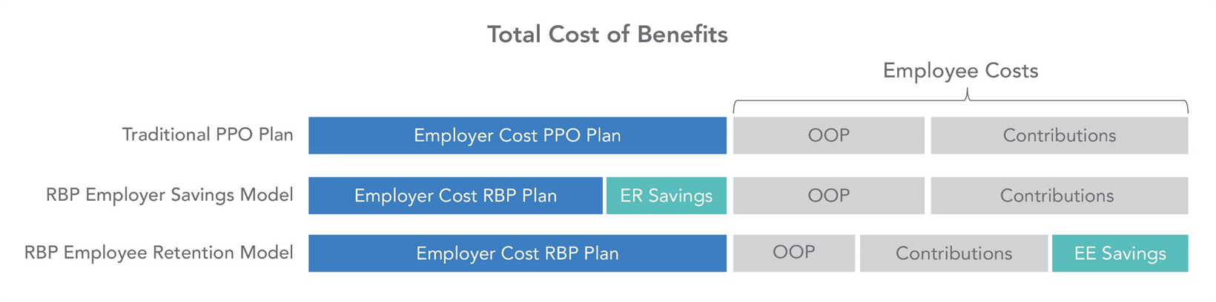
Using RBP to Attract & Retain Employees
RBP has evolved from a low-cost, low-wage solution for blue- and gray-collar employees and may now be considered as strategy to attract and retain employees.
Wage and healthcare inflation may make offering affordable benefits impossible for many employers.
Many employees would appreciate the value of an RBP plan that delivers lower out-of-pocket, lower contributions, and broad provider access.
When combined with either a dual option strategy or direct contracting strategy, this reaches a broader set of employees’ needs.

Slide 7
Maximizing Value of the Healthcare Dollar: Appropriate vs. Excessive Hospital Reimbursements
Most experts agree, there is no direct correlation between cost and quality in hospital care, yet hospitals bill vastly different amounts based on “brand.”
Cost vs. Quality | Houston, Tx Hospital Facilities
Cost as a multiple of Medicare
Quality in Hospital Care
Billed as Medicare Multiple
Source: MediVI software platform, an industry-leading source of transparent hospital financial and quality data.
Why pay more for lower quality?

Slide 8
Understanding Compliance Concerns
USI assists employers to evaluate the compliance concerns that may accompany an RBP plan and preemptively address potential issues before they occur.
Compliance Concern
RBP Vendor Response
Balance Billing
Hospitals and facilities may bill members for the balance.
Members with out-of-pocket costs (OOP) exceeding the ACA MOOP or preventive services not covered at 100% may file a claim against the employer.
This may lead to a DOL investigation to determine if the plan is out of compliance with the ACA.
RBP vendors believe that since there is no network with the plan, the MOOP doesn’t apply. The RBP vendors evaluated by USI all have taken preventative measures to offer members limited indemnity from balance billing. RBP vendors typically have a negotiation corridor of 140% to 200% of the Medicare reimbursement which is “reasonable” and should be accepted by most facilities.
Fiduciary Responsibility
RBP vendors often accept co-fiduciary status, but it doesn’t eliminate the plan sponsor’s responsibility.
Concern is that exposing members to large out-of-pocket (OOP) MAY not be in the best interest of the plan members.
Employers who fail to ensure that plan assets are being spent appropriately are not acting in the best interest of participants.
Is a $1,000 toothbrush an appropriate expense under the plan?
Is $80 for a “mucus recovery systems” AKA box of tissues an appropriate expense under the plan?

Slide 9
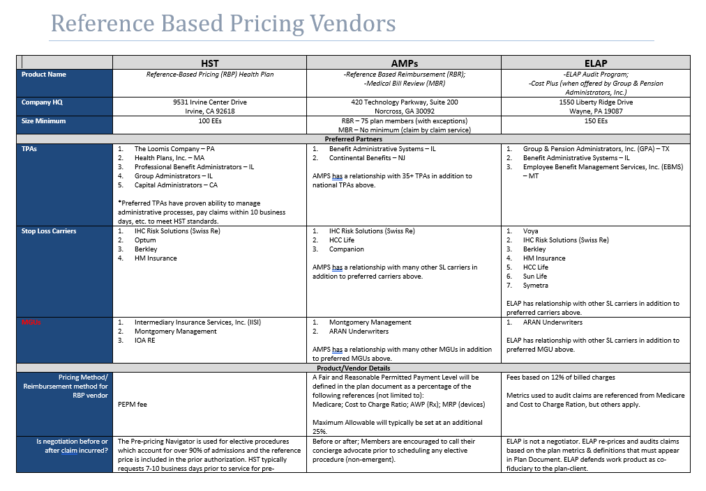
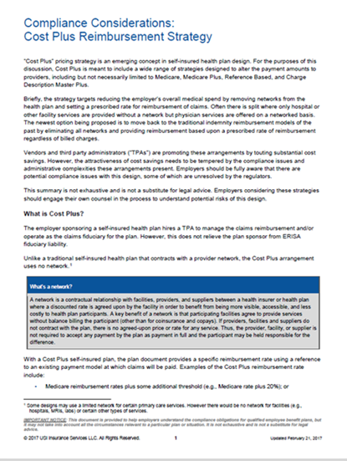

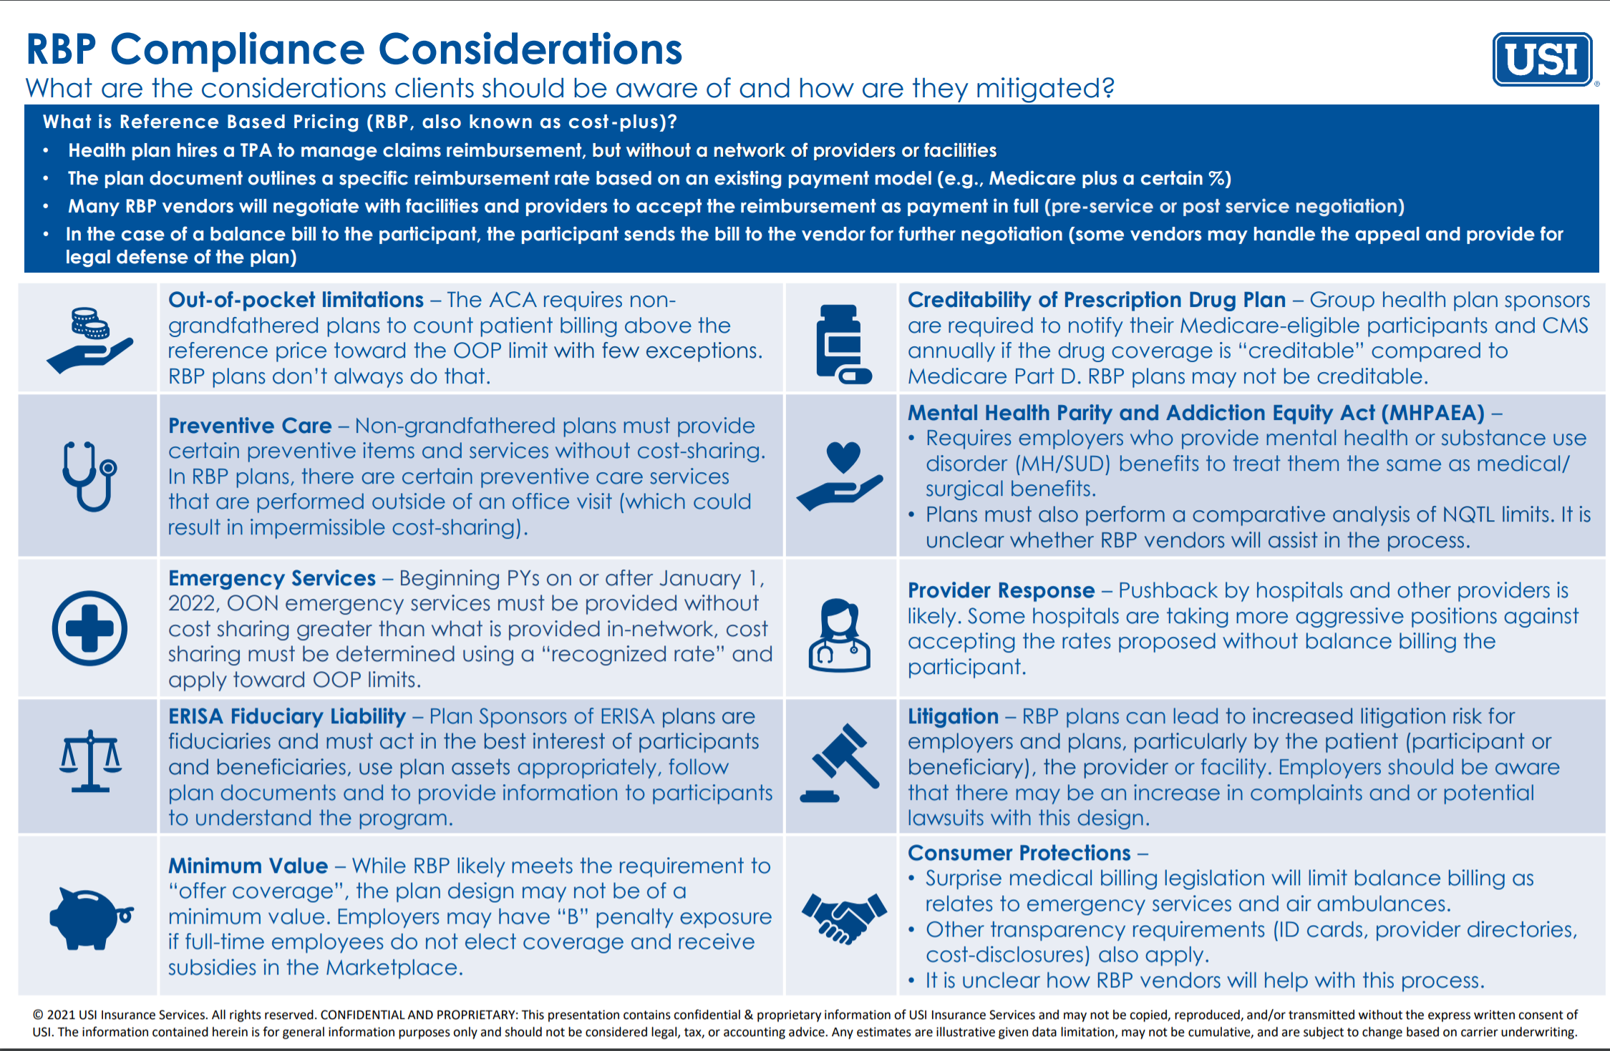
USI Expertise with RBP Plans
With over 150 RBP plans under management, USI offers the expertise and experience necessary to successfully evaluate and implement an RBP strategy.
A variety of vendors offer widely varying solutions with substantially different costs and strategies.
There are numerous details that must be addressed with an RBP plan to ensure a successful implementation.
Stop loss coverage must be designed to appropriately cover the negotiated payment corresponding fees.
Effectively communicating the details of the RBP plan are essential to success.
Understanding of compliance risks

Slide 10
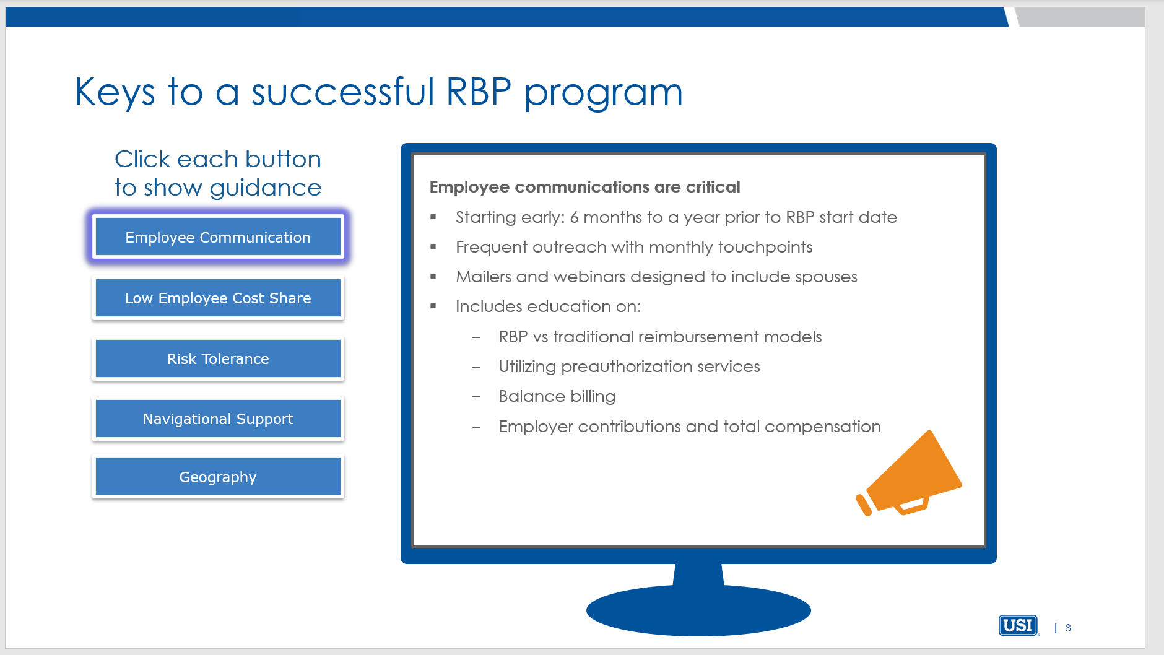
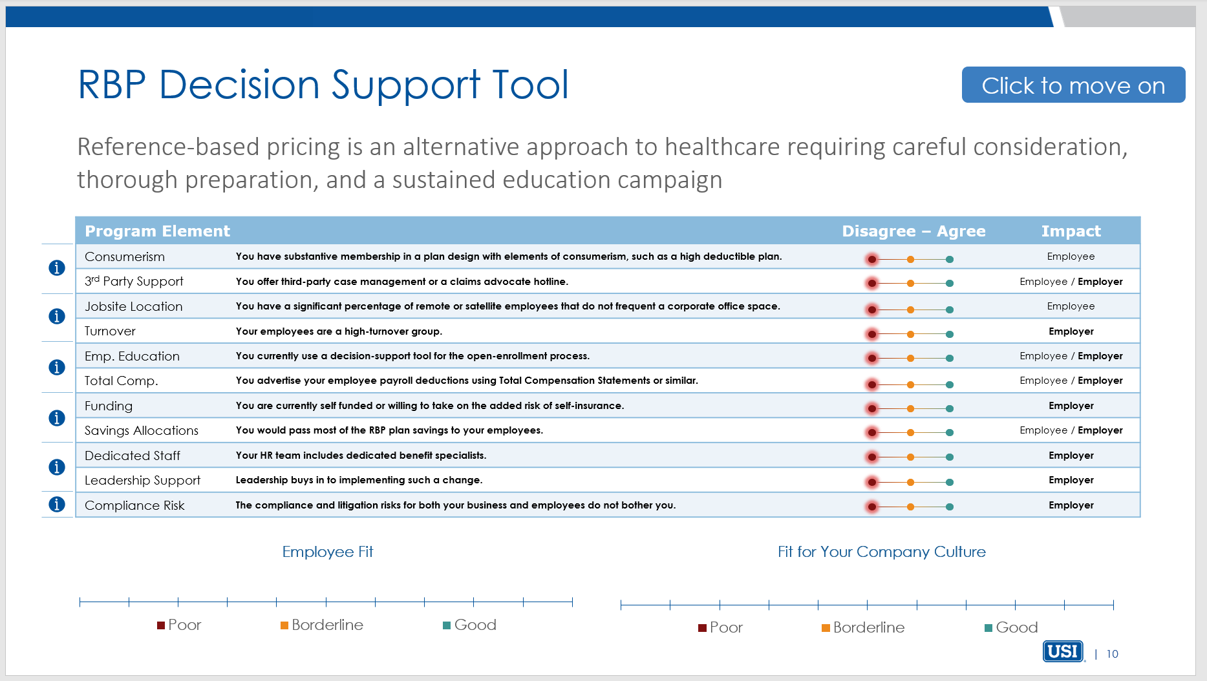
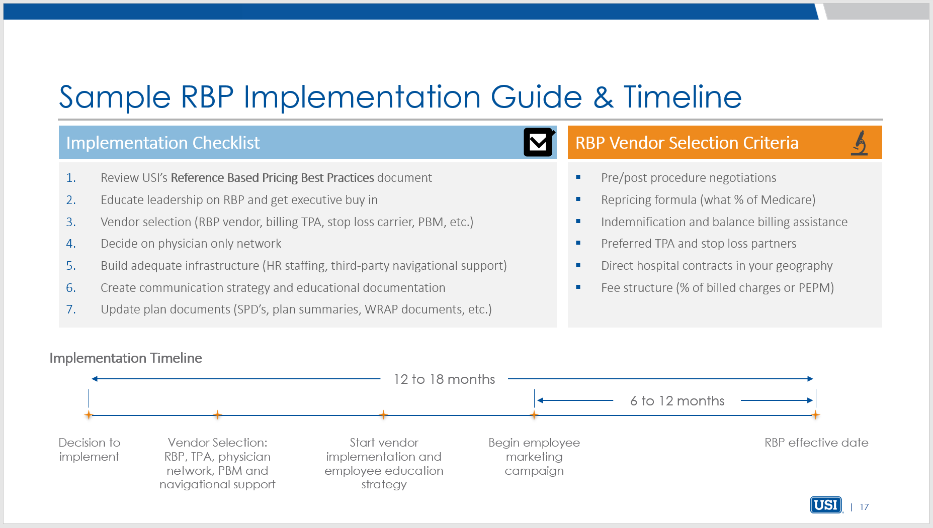
USI’s RBP Interactive Guidance Tool
USI developed this interactive tool to help employers determine their readiness for Reference-Based Pricing plans.
Unique tool provides employers with a detailed comparison of traditional reimbursement models to RBP models as well as an overview of what makes a RBP plan successful.
An interactive questionnaire generates a scorecard which identifies both the employer and employees’ readiness for an RBP plan.

Slide 11
Setup a meeting to complete the RBP Interactive Guidance Tool.

Slide 12
Sources and Notes for Charts
Price Increases from 1983 to 2017: CPI for Hospital Services, CPI for Medical Services and CPI for All Items Chart Source: Perry, M. J. (2018b, June 11). What causes hyperinflation for medical costs in the US? Medical insurance, which is the problem, not the solution. American Enterprise Institute. https://www.aei.org/carpe-diem/what-causes-hyperinflation-for-medical-costs-in-the-us-medical-insurance-which-is-the-problem-not-the-solution/
Hospital and Health System M&A Activity, 2000-2017 Chart Source: LaPointe, J. (2018, July 20). How Hospital Merger and Acquisition Activity is Changing Healthcare. Revcycle Intelligence. https://revcycleintelligence.com/features/how-hospital-merger-and-acquisition-activity-is-changing-healthcare
Health Care Spending as a Percent of GDP, 1980 – 2018 Chart Notes: Current expenditures on health. Based on System of Health Accounts methodology, with some differences between country methodologies. GDP = gross domestic product. OECD average reflects the average of 36 OECD member countries, including ones not shown here. 2018 data are provisional or estimated. Data: OECD Health Statistics 2019 Source: Roosa Tikkanen and Melinda K. Abrams, U.S. Health Care from a Global Perspective, 2019: Higher Spending, Worse Outcomes (Commonwealth Fund, Jan. 2020)

